Slide 1
Personality
Prediction
SEMESTER 5 MINI PROJECT

Slide 2
Guide - Prof. Suja Jayachandran
01 | Vaidehi Bhamare 19101B0002
02 | Eshika Purohit 19102B0007
03 | Khyati Maru 19102B0015
04 | Shital Bokade 19102B0034

Slide 3
ABSTRACT
Personality is useful for recognizing how people lead, influence, communicate, collaborate, negotiate business and manage stress. This project is helpful where we have data which contains the aspects and basis of personality prediction. This personal behaviour data can be useful for identifying person based on his/her personality traits. The personality characteristics will be already stored in the database and when user enters their information and attempt the quiz, the input is examined in system will detect the personality of user. It is based on Big Five Personality Traits, also known as OCEAN. This data can be helpful to classify persons using Automated personality classification (APC). In this project, we propose a system which analyses the personality of the user and will overall help themselves get a better insight on themselves.

Slide 4
PROBLEM DEFINITION
Nowadays personality assessment has become the most used test to hire many employees.
Classifying the personality of the user based on the big five personality traits using Unsupervised and Supervised Machine Learning concepts.
We want a version that predicts the personality of people primarily based totally on their creativeness and thoughts. The purpose of this project is to construct a model that predicts the personality of the people.
The main goal of the proposed system is to predict the personality of the user by the answers given by the user. The project is aimed at developing software which will be helpful in identifying the personality of the person.
After classification is done the user type personality will be displayed.

Slide 5
WHY THIS SYSTEM??
This project proposes several new research directions regarding the problem of Automated Personality Classification (APC).
01
Personality classification is one of the problems considered by personality psychology, a branch of psychology. The focus of this field is the study of personality and individual differences.
02
The standard approach to solving the APC problem:
A) Gathering the corpus data.
B) Determination of the personality characteristics of the participants
C) Building the model
03

Slide 6
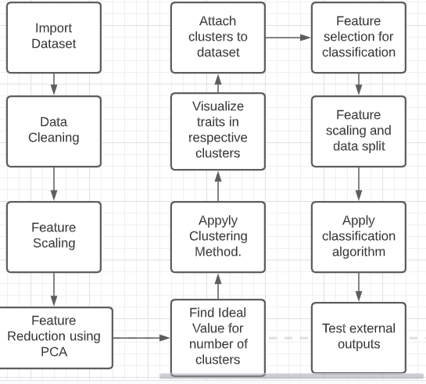
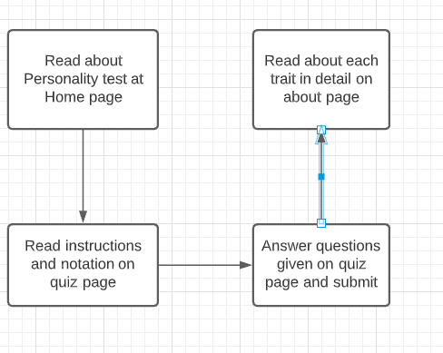
FLOW DIAGRAM

Slide 7
CONCLUSION
Personality prediction has always been useful since the very beginning. These systems have been used in E-commerce sites, in competitive exams, psychometric tests, matrimonial sites, Government sectors like Army, Navy, Air Force. In this project, we discuss how the personality is identified using different ML clustering algorithms. The personality is automatically classified by the system after the user attempts the quiz using the data set provided in the back end. At the end when the results are displayed, a graph is shown which depicts the percentage of the OCEAN personality along with some insights on how the overall personality is. With the help of the current trending domain i.e., Machine Learning we designed a personality prediction system. Through this project we aimed at helping individuals who want to get to know more about themselves.

Slide 8
FUTURE SCOPE
1
Personality prediction always has and will play an integral part of various interview processes in a lot of different sectors. In our project we aimed to create a basic system which overcomes the old traditional methods.
We predict the personality of a user through a quiz. As personality tests are now becoming a part of hiring processes, we can take our built system to a whole different level.
Using Machine Learning which is growing and will continue to we can develop a more complex system which can be customized according to the situations and requirements. We can predict if the person is suitable to become an entrepreneur or what kind of career can suit you best according to your personality.
With the technological enhancements and the researches being conducted on this topic we can modify our proposed system.
2
3
4

Slide 9
REFERENCES
[1] Mitchell, Tom (1997). Machine Learning. New York: McGraw Hill. ISBN 0-07-042807-7. OCLC 36417892.
[2] Friedman H, Schustack M (2016). Personality: Classic Theories and Modern Research (Sixth ed.). Pearson Education Inc. ISBN 978-0205997930
[3] Randall Wald, Taghi M. Khoshgoftaar, Amri Napolitano, Chris Sumner (2012). Using Twitter Content to Predict Psychopathy, 11th International conference on Machine Learning and Applications, IEEE.
[4] Educational Game Yago Saez, Carlos Navarro, Asuncion Mochon and Pedro Isasi (2014). A system for personality and happiness detection, International Journal of Interactive Multimedia and Artificial Intelligence.
[5] Nuribha A Shukora, Zaidatun Tasira, Henny Vander Meijden (2015). An Examination of Online Learning Effectiveness using Data Mining, Science Direct – Procedia – Social and Behavioral Sciences 172, 555-562.
[6] Martin Gerlach, William Revelle, Luís A Nunes Amaral, Beatrice Farb (2018). A robust data-driven approach identifies four personality types across four large data sets.

Slide 10
Thank You

